Slide 1
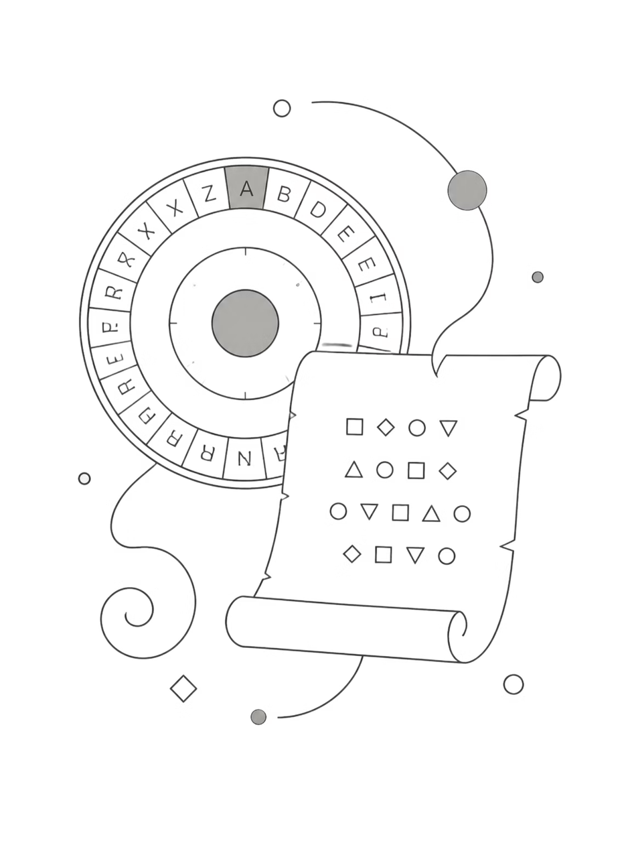

Famous Historical Cryptographic Machines and Events
How secret codes shaped history — from simple shifts on parchment to electromechanical machines that altered the course of wars.
Rishabh Alpeshabhai Shah
Raj Jaydeepsinh Mahendrasinh
Enrolment: 23SS02IT181
Enrolment: 23SS02IT160
Shakib Ahmed Mohammad Faruk Bhorania
Enrolment: 23SS02IT240
Notes:
1

Slide 2
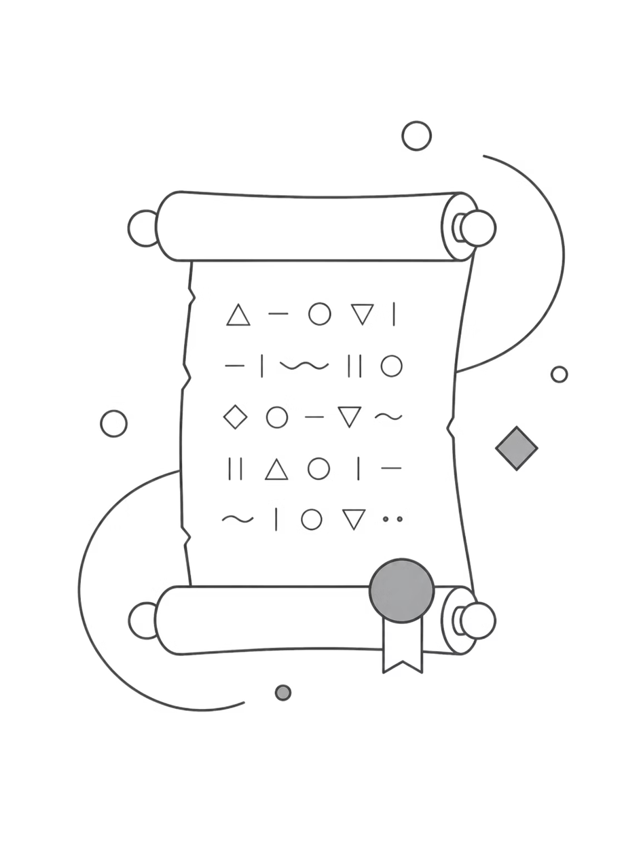




What is Cryptography?
Cryptography is the art and science of hiding and protecting information. It has two core stages: encryption (turning a message into a secret form) and decryption (recovering the original message).
Purpose
Protect messages from enemies, spies, and unauthorized readers.
Contexts
Used in war, diplomacy, commerce, and modern digital communications.
History
Practiced since ancient times — evolving with technology and mathematical ideas.
Notes:
2

Slide 3
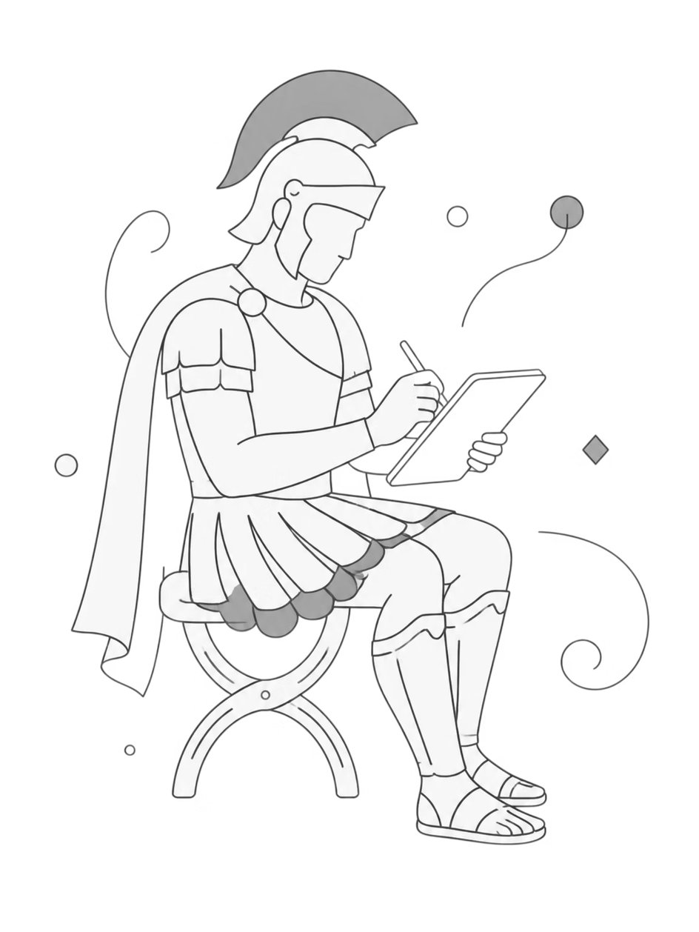
Caesar Cipher — Ancient Rome
The Caesar cipher shifts each letter by a fixed number. Julius Caesar used it to conceal military orders: for example, A shifted by 3 becomes D.
How it works
Replace each letter with another a fixed distance away in the alphabet.
Strengths & limits
Simple and fast for its time; easily broken with frequency analysis or brute force.
Legacy
One of the earliest documented ciphers — a stepping stone to more advanced methods.
Notes:
3

Slide 4



The Scytale — Ancient Greece
The scytale is a physical cipher: a strip of parchment wrapped around a rod. Only the correct rod diameter restores the message’s readable order — an early example of requiring the right 'key' object.
Use
Military communications, notably by Spartans for quick, secure orders.
Concept
Demonstrates that encryption can be physical as well as written — the rod is the secret key.
Notes:
4

Slide 5
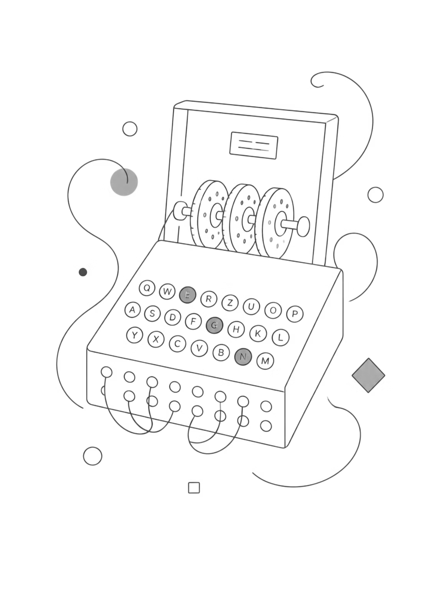
The Enigma Machine
An electromechanical cipher machine used by Germany in World War II. With rotating rotors and plugboard wiring, Enigma produced a vast number of settings — making messages appear random to interceptors.
Design
Keyboard, lamps, rotors — each keypress mapped through changing electrical paths.
Belief
Germany considered it unbreakable; operational security sometimes relied on this confidence.
Notes:
5

Slide 6


Breaking Enigma — Allied Effort
British cryptanalysts, including Alan Turing, developed techniques and machines (the Bombe) to deduce Enigma settings. Cracking Enigma shortened the war by giving the Allies timely intelligence.
01
02
03
Intercept
Analyse
Automate
Collect encrypted messages and operational clues.
Identify predictable message patterns and key reuse.
Use the Bombe to test rotor and plugboard combinations rapidly.
Alan Turing’s work laid foundations for modern computing as well as cryptanalysis.
Notes:
6

Slide 7
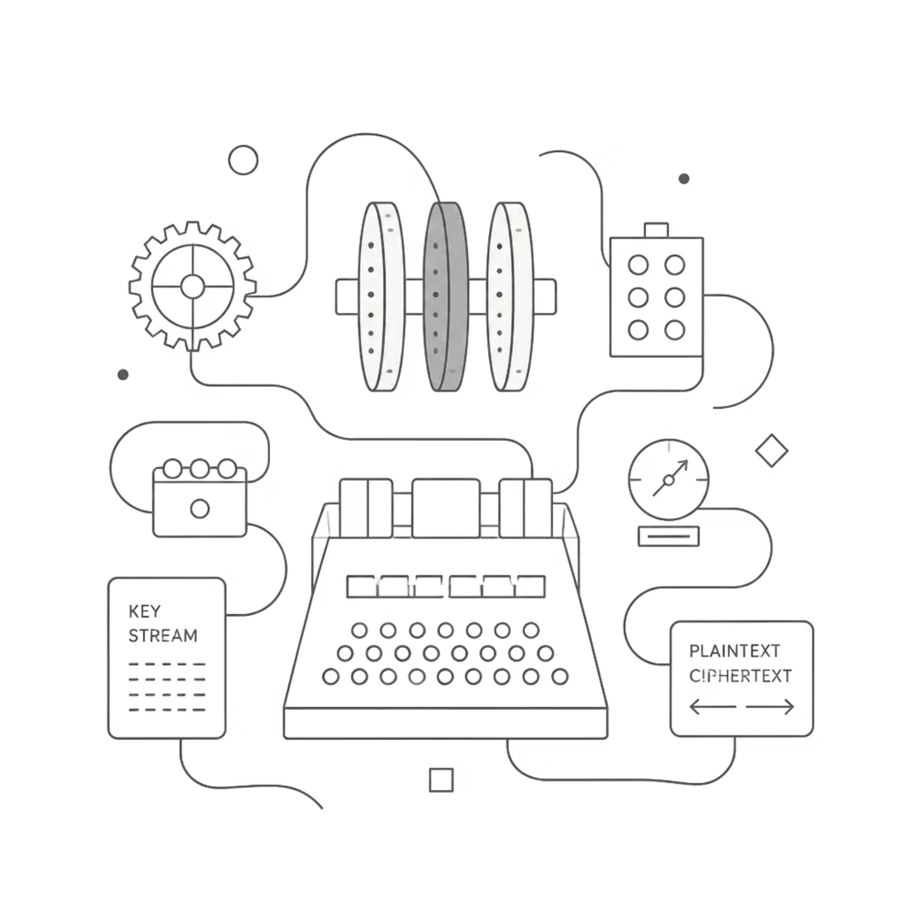
The Lorenz Cipher & Colossus
Lorenz SZ was used by German High Command for top-secret traffic. It was more complex than Enigma and required new methods to break.
Breakthrough
British cryptanalysts used pattern analysis and built Colossus — one of the first programmable electronic computers — to speed decryption.
Impact
Access to High Command messages influenced strategic
Allied decisions.
Notes:
7

Slide 8



Navajo Code Talkers — Secure Voice Communication
The U.S. Marine Corps used native Navajo speakers to transmit secure radio messages in World War II. The Navajo language — combined with special code terms — produced a fast, reliable cipher that remained unbroken by enemies.
Speed
Messages were encoded and transmitted quickly — crucial in fast-moving battles.
Security
Language and code words created a practical, human-based encryption method.
Notes:
8

Slide 9
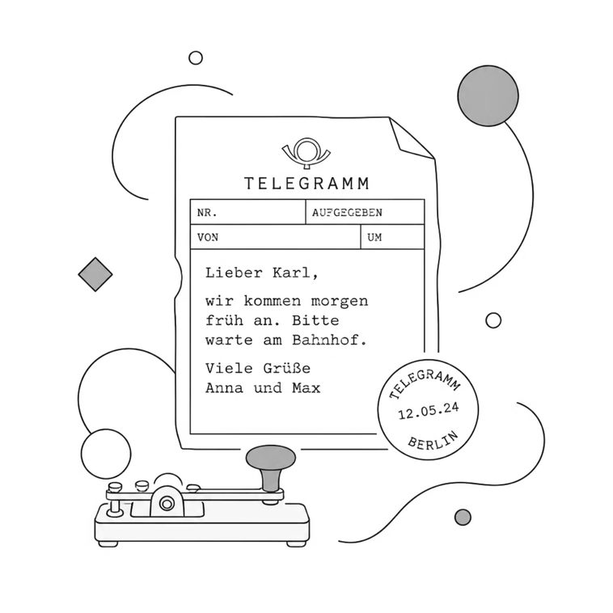
The Zimmermann Telegram
A coded German message in World War I proposing an alliance with Mexico against the USA. British interception and decoding exposed the plan and helped push the United States into the war.
Why it mattered
Lesson
Shows how intercepted diplomatic codes can change geopolitical events.
Even powerful states can be undone by leaked or broken secrets.
Notes:
9

Slide 10
From Playfair to Public-Key — The Path to Modern Cryptography
Techniques evolved from manual ciphers (Playfair, 1854) to electromechanical machines (Enigma, Lorenz) and then to mathematical algorithms after WWII. Public-key cryptography (1970s) enabled secure internet commerce and today’s digital privacy.
Playfair
Colossus Era
Modern Era
Pairwise encryption that improved over single-letter substitution.
Early electronic computation used to break complex ciphers.
Algorithms and keys protect banking, messaging, and identity online.
Key takeaway: cryptography shaped history and continues to secure our digital lives.
Notes:
10

